Slide 1
Hidden Markov Models
Jeih-weih Hung, July 4, 2001

Slide 2
Introduction
Hidden Markov Model (HMM)
  History
  Published in papers of Baum in late 1960s and early 1970s
  Introduced to speech processing by Baker (CMU) and Jelinek (IBM) in the 1970s
  Assumption
  Speech signal can be characterized as a parametric random process
  Parameters can be estimated in a precise, well-defined manner
  Three fundamental problems
  Evaluation of probability (likelihood) of a sequence of observations given a specific HMM
  Determination of a best sequence of model states
  Adjustment of model parameters so as to best account for observed signal

Slide 3
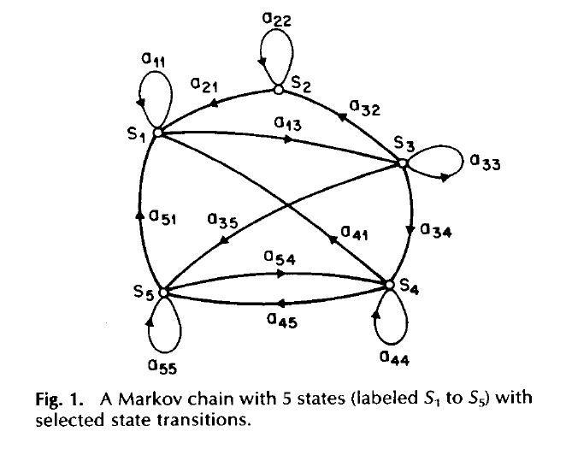
Observable Markov Model
Observable Markov Model (Markov Chain)
  First-order Markov chain of N states is a triple (S,A,π)
    S is a set of N states
    A is the NN matrix of transition probabilities between states
    P(q_{t}=j|q_{t-1}=i, q_{t-2}=k, ……)=P(q_{t}=j|q_{t-1}=i)≡A_{ij}
    π is the vector of initial state probability
    π_{j} =P(q₀=j)
  The output of the process is the set of
  states at each instant of time,
  when each state corresponds to an
  observable event
  The output in any given state is
  not random. (deterministic!)
  Too simple to describe the speech
  signal characteristics

Slide 4
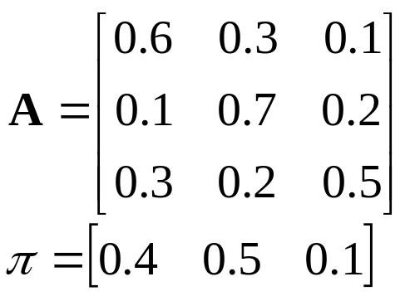
Observable Markov Model
An example : a 3-state Markov Chain Λ
  State 1 generates symbol A only,
  State 2 generates symbol B only,
  and State 3 generates symbol C only
  Given a sequence of observed symbols O={CABBCABC}, the only one corresponding state sequence is {S₃S₁S₂S₂S₃S₁S₂S₃}, and the corresponding probability is
  P(O|Λ)=P(q₀=S₃) P(S₁|S₃)P(S₂|S₁)P(S₂|S₂)P(S₃|S₂)P(S₁|S₃)P(S₂|S₁)P(S₃|S₂)
  =0.10.30.30.70.20.30.30.2=0.00002268
0.6
s₁
A
0.3
0.3
0.3
0.1
0.7
s₂
0.2
s₃
0.7
0.2
B
C

Slide 5
Hidden Markov Model
HMM, an extended version of OMM
  The observation is turned to be a probabilistic function (discrete or continuous) of a state instead of an one-to-one correspondence of a state
  The model is a doubly embedded stochastic process with an underlying stochastic process that is not directly observable (hidden)
    What is hidden? The State Sequence!
    According to the observation sequence, we are not sure which state sequence generates it!
Elements of an HMM (State-output HMM) {S,A,B,π}
  S is a set of N states
  A is the NN matrix of transition probabilities between states
  B is a set of N probability functions, each describing the observation probability with respect to a state (further discussed later)
  π is the vector of initial state probability

Slide 6
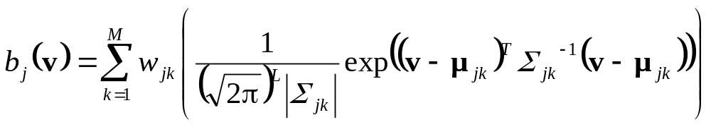
Hidden Markov Model
Two types of HMM’s according to the observations
Discrete and finite observation :
  The observations that all distinct states generate are finite in number
  V={v₁, v₂, v₃, ……, v_{M}}, v_{k}∈R^{L}
  In this case, the set of observation probability distributions B={b_{j}(v_{k})}, is defined as b_{j}(v_{k})=P(o_{t}=v_{k}|q_{t}=j), 1≤k≤M, 1≤j≤N
  o_{t} : observation at time t, q_{t} : state at time t
  ⇨ for state j, b_{j}(v_{k}) consists of only M probability values
Continuous and infinite observation :
  The observations that all distinct states generate are infinite and continuous, that is, V={v| v∈R^{L}}
  In this case, the set of observation probability distributions B={b_{j}(v)}, is defined as b_{j}(v)=f_{O|Q}(o_{t}=v|q_{t}=j), 1≤j≤N
  ⇨ b_{j}(v) is a continuous probability density function and is often a mixture of Gaussian (Normal) distributions

Slide 7
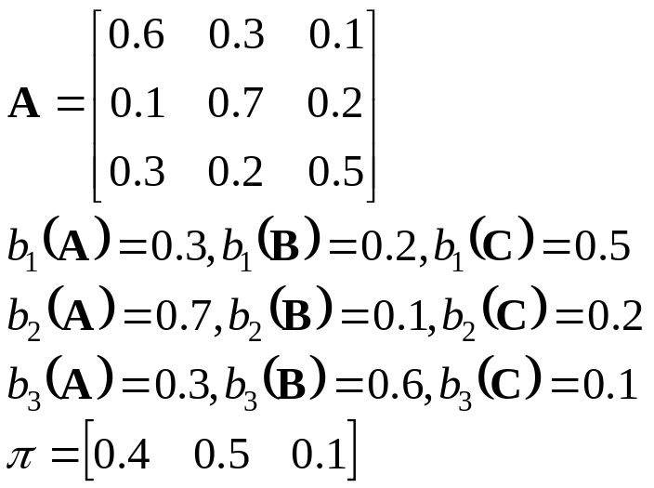
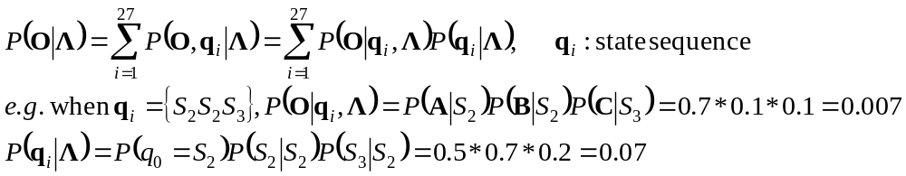
Hidden Markov Model
An example : a 3-state discrete HMM Λ
  Given a sequence of observations O={ABC}, there are 27 possible corresponding state sequences, and therefore the corresponding probability is
0.6
s₁
{A:.3,B:.2,C:.5}
0.3
0.3
0.3
0.1
0.7
s₂
0.2
s₃
0.7
0.2
{A:.7,B:.1,C:.2}
{A:.3,B:.6,C:.1}

Slide 8
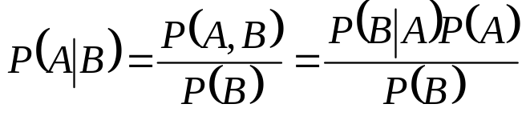
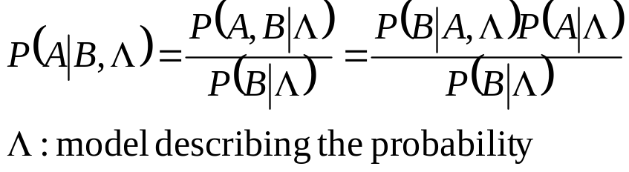

Hidden Markov Model
Notation :
  O={o₁o₂o₃……o_{T}}: observation (feature) sequence
  q= {q₁q₂q₃……q_{T}} : state sequence
  Λ: model, for HMM, Λ={A,B, π}
  P(O|Λ) : 用model Λ 計算 O 的機率值
  P(O|q,Λ) :在O是state sequence q 所產生的前提下, 用model Λ 計算 O 的機率值
  P(O,q|Λ) :用model Λ計算[O，q]兩者同時成立的機率值
  P(q|O,Λ) : 在已知O的前提下， 用model Λ 計算 q 的機率值
Useful formula
  Bayesian Rule :

Slide 9
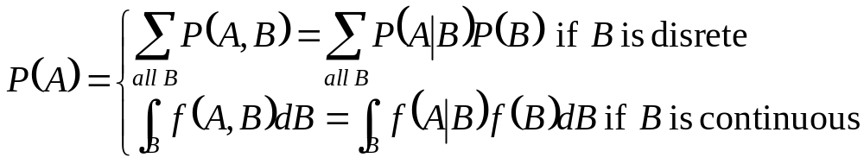
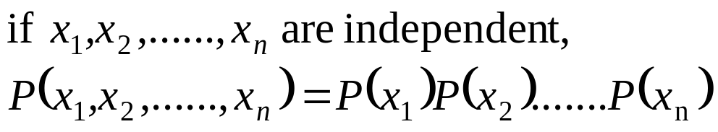
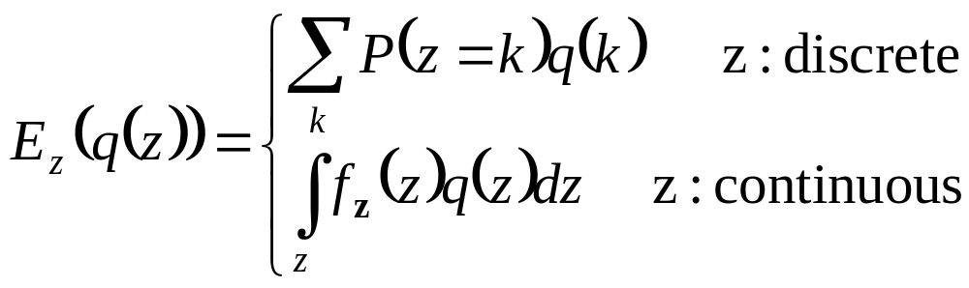
Hidden Markov Model
Useful formula (Cont.):

Slide 10
Hidden Markov Model
Three Basic Problems for HMMs
Given an observation sequence O=(o₁,o₂,…..,o_{T}), and an HMM Λ=(S,A,B,π)
  Problem 1 :
  How to efficiently compute P(O|Λ) ?
  ⇨ Evaluation problem
  Problem 2 :
  How to choose an optimal state sequence q=(q₁,q₂,……, q_{T}) ?
  ⇨ Optimality Criterion
  Problem 3 :
  How to adjust the model parameter Λ=(A,B,π) to maximize P(O|Λ)?
  ⇨ Optimizing Model Parameters

Slide 11
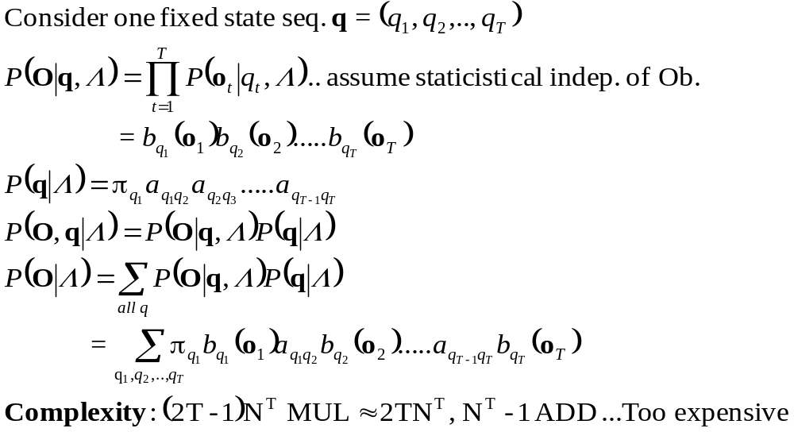
Problem 1 of HMM
Solution to Problem 1 -Probability Evaluation

Slide 12
Hidden Markov Model
The probability of the observations corresponding to a certain state sequence:
State
s₁
s₁
s₁
s₁
s₁
s₂
s₂
s₂
s₂
s₂
s₃
s₃
s₃
s₃
s₃
1 2 3 T-1 T time
O₁
O₂
O₃
O_{T-1}
O_{T}
s_{i}
means P(s_{i},o_{t}|Λ) has been computed
a_{ij}
means a_{ij} has been computed

Slide 13
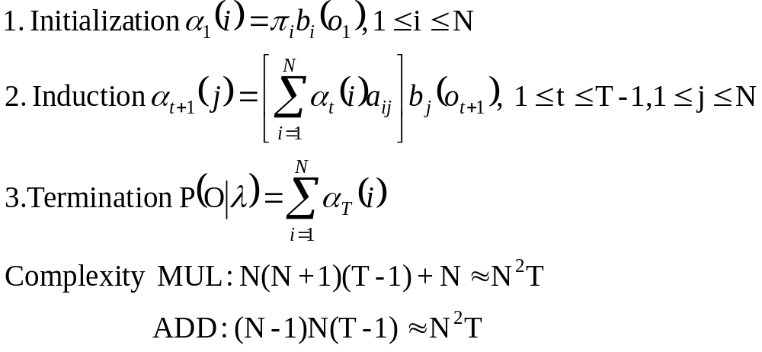
Problem 1 of HMM
Solution to Problem 1 -Probability Evaluation (Cont.)
  The forward Procedure
  forward variable : α_{t}(i)=P(o₁,o₂,…..,o_{t},q_{t}=i|Λ)
    Based on the lattice (trellis) structure
    All state sequence will remerge into these N nodes (states) no matter how long the observation sequence

Slide 14
Problem 1 : forward Procedure
α₃(1)=P(o₁,o₂,o₃,q₃=1| Λ)
State
s₁
s₁
s₁
s₁
s₁
s₂
s₂
s₂
s₂
s₂
s₃
s₃
s₃
s₃
s₃
1 2 3 T-1 T time
O₁
O₂
O₃
O_{T-1}
O_{T}
s_{i}
means P(s_{i},o_{t}|Λ) has been computed
a_{ij}
means a_{ij} has been computed

Slide 15
Problem 1 : forward Procedure
α₃(1)=P(o₁,o₂,o₃,q₃=1| Λ)= [α₂(1)*a₁₁+ α₂(2)*a₂₁ +α₂(3)*a₃₁]b₁(o₃)
State
s₁
s₁
s₁
s₁
s₁
s₁
s₁
s₁
s₁
s₁
s₂
s₂
s₂
s₂
s₂
s₂
s₂
s₂
s₂
s₃
s₃
s₃
s₃
s₃
s₃
s₃
s₃
s₃
1 2 3 T-1 T time
O₁
O₂
O₃
O_{T-1}
O_{T}

Slide 16
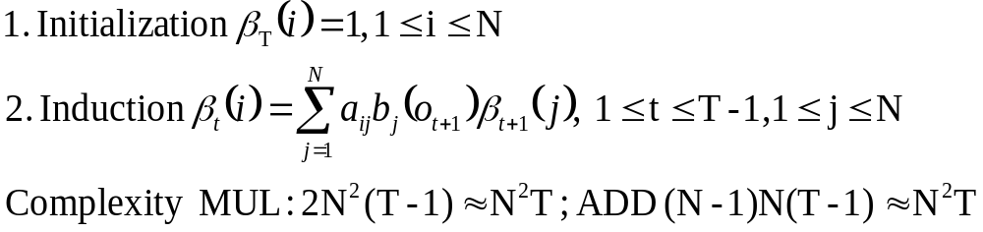
Problem 1 of HMM
Solution to Problem 1 -Probability Evaluation (Cont.)
  The backward Procedure

Slide 17
Problem 1 : backward procedure
β₂(1)=P(o₃,o₄,…, o_{T}|q₂=1,Λ)
State
s₁
s₁
s₁
s₁
s₁
s₁
s₂
s₂
s₂
s₂
s₂
s₂
s₃
s₃
s₃
s₃
s₃
s₃
1 2 3 T-1 T time
O₁
O₂
O₃
O_{T-1}
O_{T}
s_{i}
means P(s_{i},o_{t}|Λ) has been computed
a_{ij}
means a_{ij} has been computed

Slide 18
Problem 1 : backward procedure
β₂(1)=P(o₃,o₄,…, o_{T}|q₂=1,Λ)
=a₁₁* b₁(o₃)*β₃(1) +a₁₂* b₂(o₃)*β₃(2)+a₁₃* b₁(o₃)*β₃(3)
State
s₁
s₁
s₁
s₁
s₁
s₁
s₁
s₁
s₁
s₁
s₁
s₁
s₁
s₁
s₁
s₁
s₂
s₂
s₂
s₂
s₂
s₂
s₂
s₂
s₂
s₂
s₂
s₂
s₂
s₂
s₂
s₂
s₃
s₃
s₃
s₃
s₃
s₃
s₃
s₃
s₃
s₃
s₃
s₃
s₃
s₃
s₃
s₃
1 2 3 T-1 T time
O₁
O₂
O₃
O_{T-1}
O_{T}

Slide 19
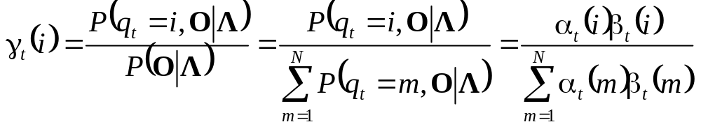
Problem 2 of HMM
Problem 2 :How to choose an optimal state sequence q=(q₁,q₂,……, q_{T}) ?
  The first optimal criterion : choose the states q_{t} are individually most likely at each time t
  Define a posteriori probability variable γ_{t}(i)= P(q_{t} = i | O, Λ)
    Solution : q_{t}* = arg_{i} max [γ_{t}(i)], 1 ≤ t ≤ T
    Problem: maximizing the probability at each time t individually
    q*= q₁*q₂*…q_{T}* may not be a valid sequence (e.g. a_{qt*qt+1*} = 0)

Slide 20
Problem 2 of HMM
P(q₃ = 1 ,O | Λ)
State
s₁
s₁
s₁
s₁
s₁
s₁
s₁
s₁
s₂
s₂
s₂
s₂
s₂
s₂
s₂
s₂
s₃
s₃
s₃
s₃
s₃
s₃
s₃
s₃
1 2 3 T-1 T time
O₁
O₂
O₃
O_{T-1}
O_{T}

Slide 21
Problem 2 of HMM
P(q₃ = 1 ,O | Λ)=α₃(1)*β₃(1)
α3(1)
β3(1)
State
s₁
s₁
s₁
s₁
s₁
s₁
s₁
s₁
s₁
s₁
s₂
s₂
s₂
s₂
s₂
s₂
s₂
s₂
s₂
s₂
s₃
s₃
s₃
s₃
s₃
s₃
s₃
s₃
s₃
s₃
1 2 3 T-1 T time
O₁
O₂
O₃
O_{T-1}
O_{T}

Slide 22
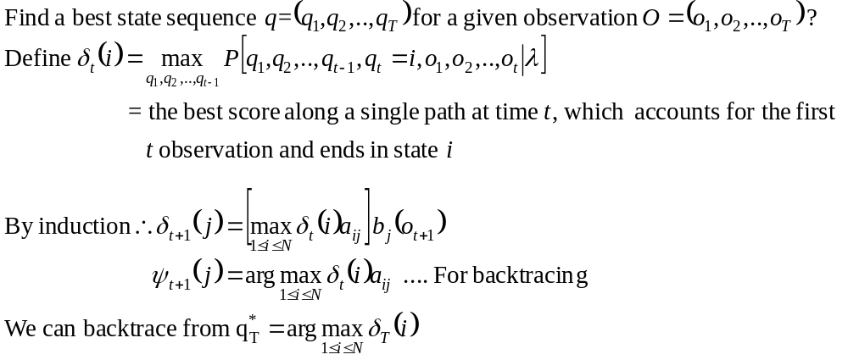
Problem 2 of HMM
Problem 2 :How to choose an optimal state sequence q=(q₁,q₂,……, q_{T}) ?
The Viterbi Algorithm

Slide 23
Problem 2 of HMM
The Viterbi Algorithm
State
s₁
s₁
s₁
s₁
s₁
s₂
s₂
s₂
s₂
s₂
s₃
s₃
s₃
s₃
s₃
1 2 3 T-1 T time
O₁
O₂
O₃
O_{T-1}
O_{T}

Slide 24
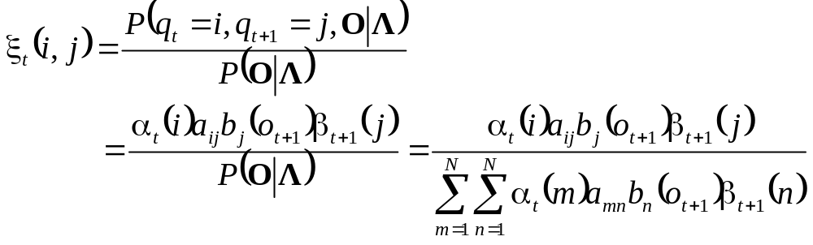
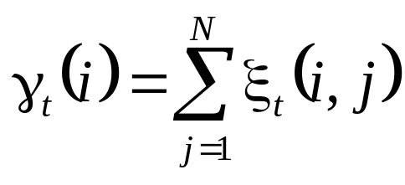
Problem 3 of HMM
How to adjust (Re-estimate) the model parameter Λ=(A,B,π) to maximize P(O|Λ)?
Intuitive view
  Define a new variable ξ_{t}( i, j )=P(q_{t} = i, q_{t+1} = j | O, Λ)
  Recall the posteriori probability variable γ_{t}(i)= P(q_{t} = i | O, Λ)

Slide 25
Problem 3 of HMM
P(q₃ = 1, q₄ = 3,O | Λ)
State
s₁
s₁
s₁
s₁
s₁
s₁
s₁
s₁
s₁
s₂
s₂
s₂
s₂
s₂
s₂
s₂
s₂
s₂
s₃
s₃
s₃
s₃
s₃
s₃
s₃
s₃
s₃
1 2 3 4 T-1 T time
O₁
O₂
O₃
O_{T-1}
O_{T}

Slide 26
Problem 3 of HMM
P(q₃ = 1, q₄ = 3,O | Λ)=α₃(1)*a₁₃*b₃(o₄)*β₄(3)
State
α3(1)
s₁
s₁
s₁
s₁
s₁
s₁
s₁
s₁
s₁
s₁
s₁
s₁
s₁
s₁
s₁
s₁
s₁
s₂
s₂
s₂
s₂
s₂
s₂
s₂
s₂
s₂
s₂
s₂
s₂
s₂
s₂
s₂
s₂
s₂
s₃
s₃
s₃
s₃
s₃
s₃
s₃
s₃
s₃
s₃
s₃
s₃
s₃
s₃
s₃
s₃
s₃
s₃
β₄(3)
1 2 3 4 T-1 T time
O₁
O₂
O₃
O_{T-1}
O_{T}

Slide 27
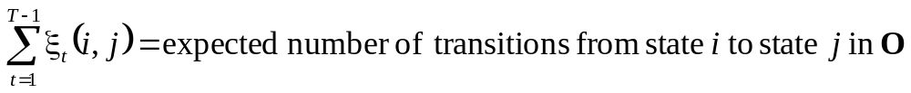
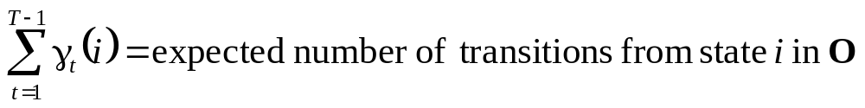
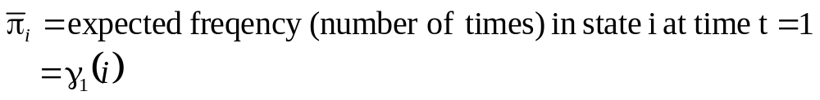
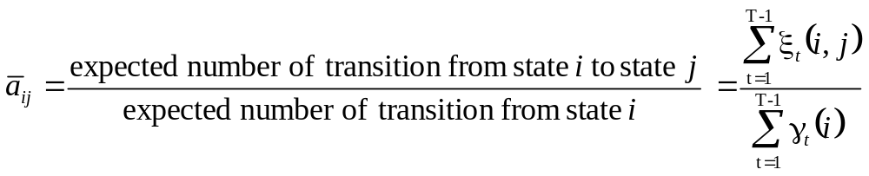
Problem 3 of HMM
Intuitive View (Cont.)
  ξ_{t}( i, j )=P(q_{t} = i, q_{t+1} = j | O, Λ)
  γ_{t}(i)= P(q_{t} = i | O, Λ)
  A set of reasonable re-estimation formula for {A,π} is

Slide 28
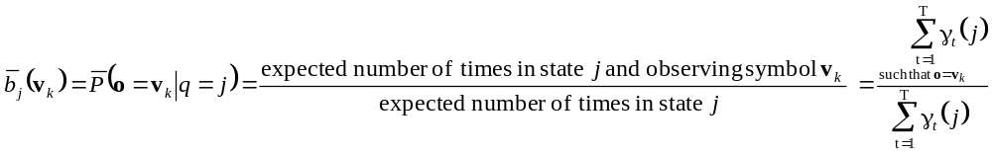
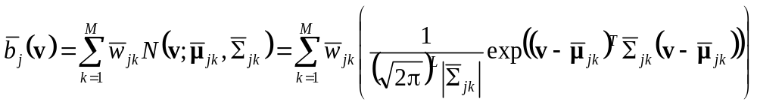
Intuitive View (Cont.)
  A set of reasonable re-estimation formula for {B} is
  For Discrete and finite observation
  b_{j}(v_{k})=P(o_{t}=v_{k}|q_{t}=j)
  For Continuous and infinite observation
  b_{j}(v)=f_{O|Q}(o_{t}=v|q_{t}=j),

Slide 29
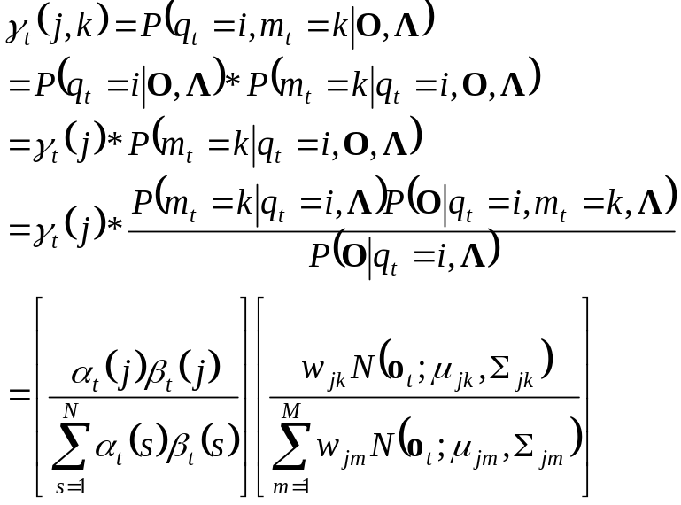
Problem 3 of HMM
Intuitive View (Cont.)
For Continuous and infinite observation (Cont.)
Define a new variable γ_{t}(j,k)
γ_{t}(j,k) is the probability of being in state j at time t with the kth mixture component accounting for o_{t}
w₁₂
w₁₁
w₁₃
N₂
N₁
N₃
Distribution for State 1

Slide 30
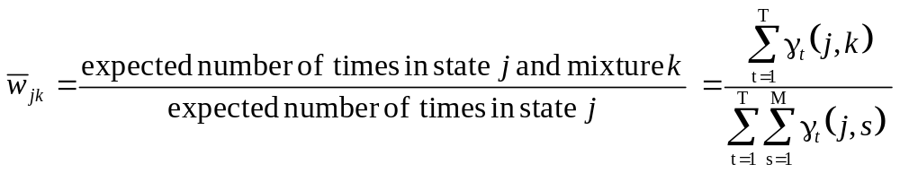
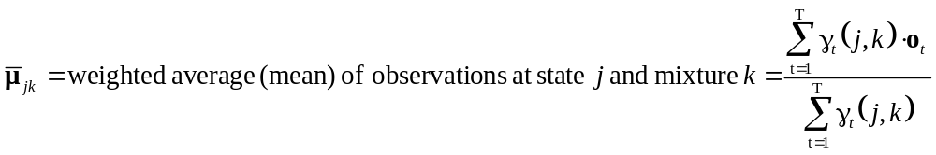
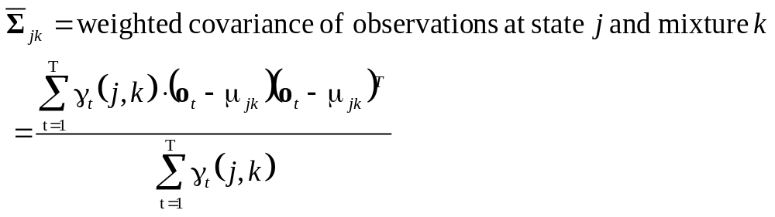
Problem 3 of HMM
Intuitive View (Cont.)
For Continuous and infinite observation (Cont.)

Slide 31
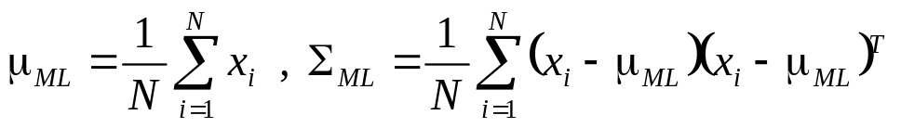
Problem 3 of HMM
A more strict mathematic view :
Expectation Maximization (EM) Algorithm
Introduction of EM:
  A common task in signal processing :
  estimation of the parameters of a probability distribution function
  Estimation Principle based on observations X=[x₁, x₂, ……, x_{N}]:
    the Maximum Likelihood (ML) Principle
    find the model parameter θ so that the likelihood P(X |θ) is maximum
    for example, if θ ={μ,Σ} is the parameters of a normal distribution, and X is i.i.d, then the ML estimate of θ ={μ,Σ} is
    the Maximum A Posteriori (MAP) Principle
    find the model parameter θ so that the likelihood P(θ |X) is maximum

Slide 32
Expectation Maximization (EM)
Introduction of EM (Cont.):
  Why EM?
    Simple optimization algorithms for likelihood function relies on the intermediate variables, called latent data
    in our case here, the state sequence is the latent data
    direct access to the data necessary to estimate the parameters is impossible or difficult
    in our case here, it is almost impossible to estimate {A,B, π} without consideration of the state sequence
  Two Major Steps :
    E : expectation with respect to the latent data using the current estimate of the parameters and conditioned on the observations
    M: provides a new estimation of the parameters according to ML or MAP

Slide 33
EM: An example
A
B
output
Observed data : O : “ball sequence”
Latent data : q : “bottle sequence”
Parameter to be estimated to maximize logP(O,q|Λ)
Λ={P(A),P(B),P(R|A),P(G|A), P(R|A), P(G|B)}

Slide 34
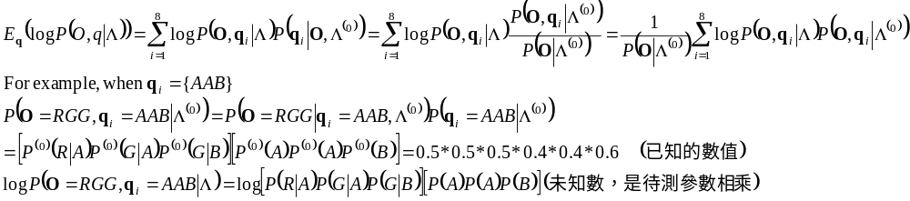
EM: An Example
First, randomly assigned Λ⁽⁰⁾={P⁽⁰⁾(A),P⁽⁰⁾(B),P⁽⁰⁾(R|A),P⁽⁰⁾(G|A), P⁽⁰⁾(R|A), P ⁽⁰⁾(G|B)}
for example : {P⁽⁰⁾(A)=0.4,P⁽⁰⁾(B)=0.6,P⁽⁰⁾(R|A)=0.5,P⁽⁰⁾(G|A) =0.5, P⁽⁰⁾(R|A) =0.5, P ⁽⁰⁾(G|B) =0.5}
Expectation Step : find the expectation of logP(O,q|Λ)
8 possible bottle sequence :{AAA},{BBB},{AAB},{BBA},{ABA},{BAB},{ABB},{BAA}
Maximization Step : find Λ to maximize the expectation function
Iteration : Λ⁽⁰⁾➔ Λ⁽¹⁾ ➔ Λ⁽²⁾ ➔ ……..

Slide 35
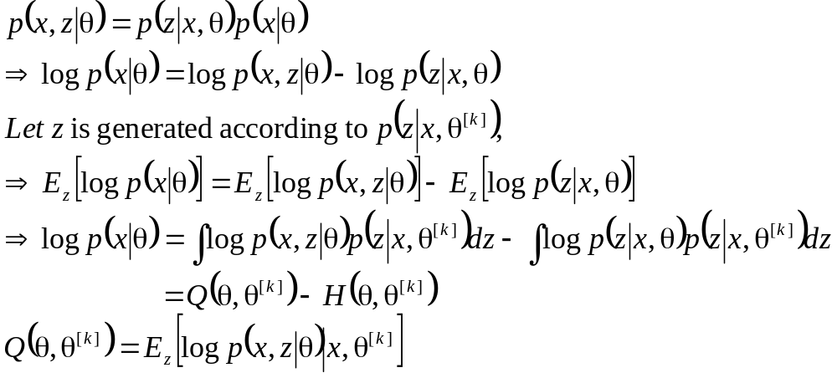
EM : General Statement
Two Steps :
  express the log-likelihood logP(x|θ^{(k+1)}) in terms of the distribution of latent data which is based on [x, θ^{(k)}]
  use the expression to invent an iteration which gives the sequence of parameters θ^{(k)}, k=1, 2, ……, s.t. logP(x|θ^{(k+1)})≥logP(x|θ^{(k)}), where x is the observed data
Log-likelihood Expression :
  x : observed (incomplete) data, z : latent data, {x, z} : complete data

Slide 36
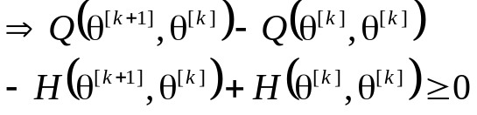
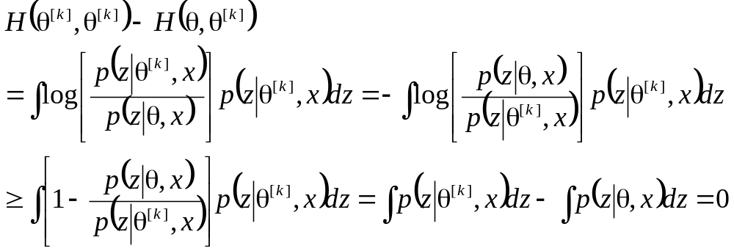
EM : General Statement (cont.)
The EM iteration :
  How to find a value θ^{[k+1]} so that logP(x|θ^{[k+1]}) ≥ logP(x|θ^{(k)})?
  However, since H(θ,θ^{[k]}) ≤H(θ^{[k]},θ^{[k]}), we only have to find θ^{(k+1)} so that
  Q(θ^{[k+1]},θ^{[k]}) -Q(θ^{[k]},θ^{[k]}) ≥ 0
  why H(θ,θ^{[k]}) ≤H(θ^{[k]},θ^{[k]})?
    Since log(x) ≤x-1

Slide 37
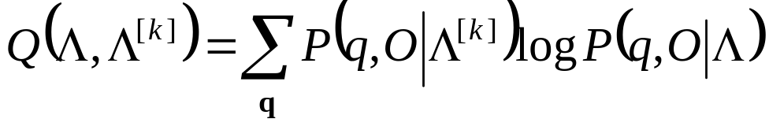

The Applications of EM Algorithm : HMM
Problem 3 of Hidden Markov Model
  Observed data : observations O, latent data : state sequence q
  The probability of the complete data is
  P(x|Λ)= P(O,q|Λ)= P(O|q,Λ)P(q|Λ)
  E-Step :
  Q(Λ, Λ^{[k]})=E[log P(O,q|Λ)|O,Λ^{[k]}]
  = Σ_{q} P(q|O,Λ^{[k]})log[P(O,q|Λ)]
    Λ^{[k]}: kth estimate of Λ (known), Λ : unknown parameter to be estimated:
    P(q|O,Λ^{[k]}) =P(O,q|Λ^{[k]}) /P(O|Λ^{[k]}), where P(O|Λ^{[k]}) can be skipped since it is independent of q
    the final auxiliary function to be maximized is
  M-Step :
    Find Λ^{[k+1]} such that Λ^{[k+1]} =arg max_{Λ}Q(Λ, Λ^{[k]})

Slide 38
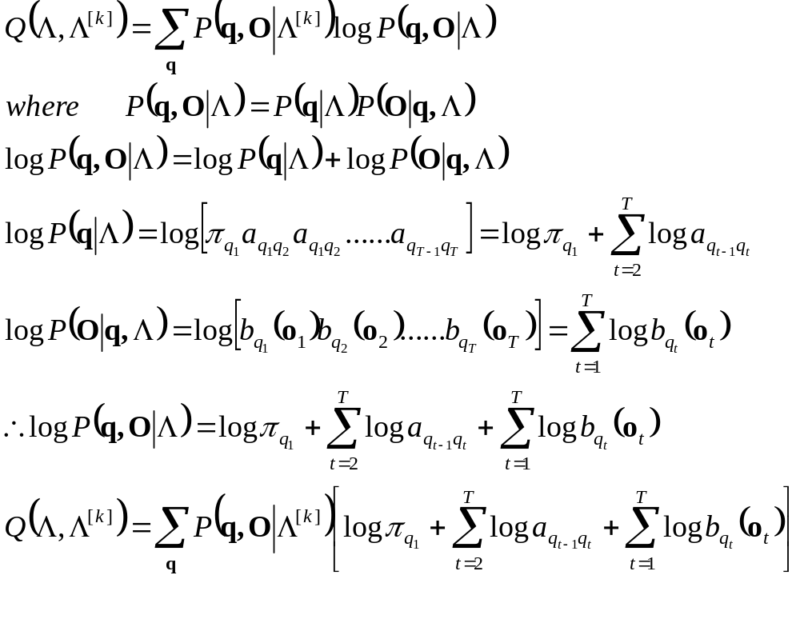
Problem 3 of HMM
The auxiliary function to be maximized in HMM :

Slide 39
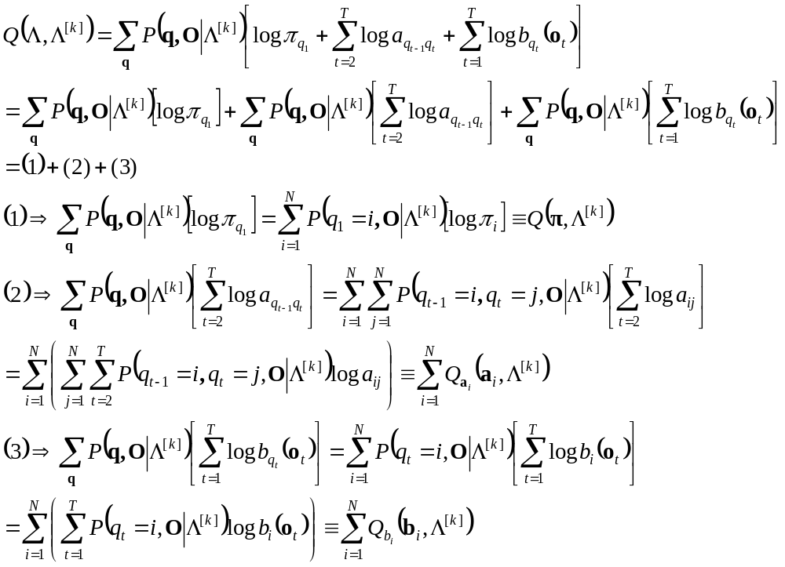
Problem 3 of HMM
The auxiliary function to be maximized in HMM : (cont.)

Slide 40
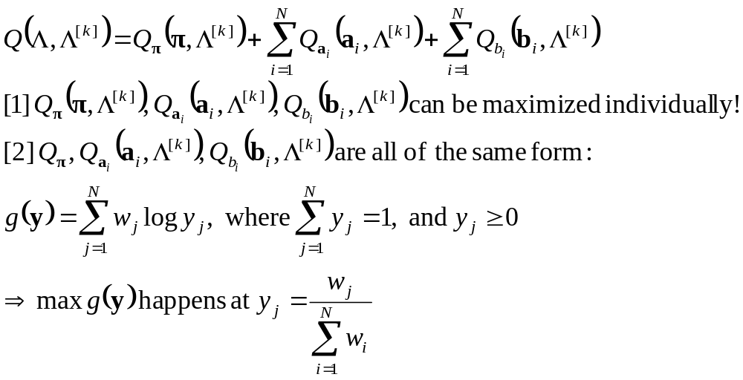
Problem 3 of HMM
The auxiliary function to be maximized in HMM : (cont.)

Slide 41
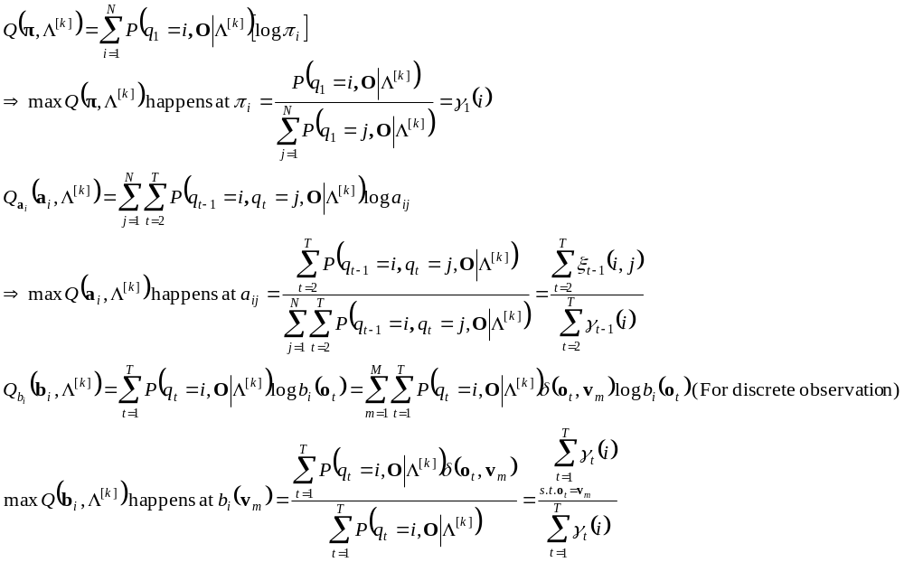
Problem 3 of HMM
The auxiliary function to be maximized in HMM : (cont.)

Slide 42
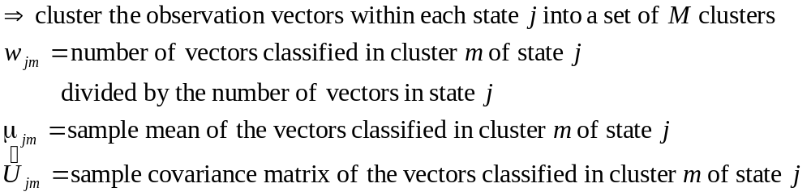
Initialization of HMM
A good initialization of HMM training :
Segmental K-Means Segmentation into States
  Assume that we have a training set of observations and an initial estimate of all model parameters
  Step 1 : The set of training observation sequences is segmented into states, based on the initial model (finding the optimal state sequence by Viterbi Algorithm)
  Step 2 :
  For discrete density HMM (using M-codeword codebook)
  For continuous density HMM (M Gaussian mixtures per state)
  Step 3: Evaluate the model score.
  If the difference between the previous and current model scores is greater than a threshold, go back to Step 1, otherwise stop the initial model is generated

Slide 43
Initialization of HMM
An example for discrete HMM
  3 states and 2 codeword
    b₁(v₁)=3/4, b₁(v₂)=1/4
    b₂(v₁)=1/3, b₂(v₂)=2/3
    b₃(v₁)=2/3, b₃(v₂)=1/3
State
s₃
s₃
s₃
s₃
s₃
s₃
s₃
s₃
s₃
s₃
s₂
s₂
s₂
s₂
s₂
s₂
s₂
s₂
s₂
s₂
s₁
s₁
s₁
s₁
s₁
s₁
s₁
s₁
s₁
s₁
1 2 3 4 5 6 7 8 9 10
O₁
O₂
O₃
O₄
O₅
O₆
O₇
O₈
O₉
O₁₀
v₁
v₂

Slide 44
Initialization of HMM
An example for Continuous HMM
  3 states and 4 Gaussian mixtures per state
State
s₃
s₃
s₃
s₃
s₃
s₃
s₃
s₃
s₃
s₂
s₂
s₂
s₂
s₂
s₂
s₂
s₂
s₂
s₁
s₁
s₁
s₁
s₁
s₁
s₁
s₁
s₁
1 2 N
O₁
O₂
O_{N}
K-means
{μ₁₂,Σ₁₂,ω₁₂}
{μ₁₁,Σ₁₁,ω₁₁}
Global mean
Cluster 1 mean
Cluster 2mean
{μ₁₃,Σ₁₃,ω₁₃}
{μ₁₄,Σ₁₄,ω₁₄}

